Slide 1
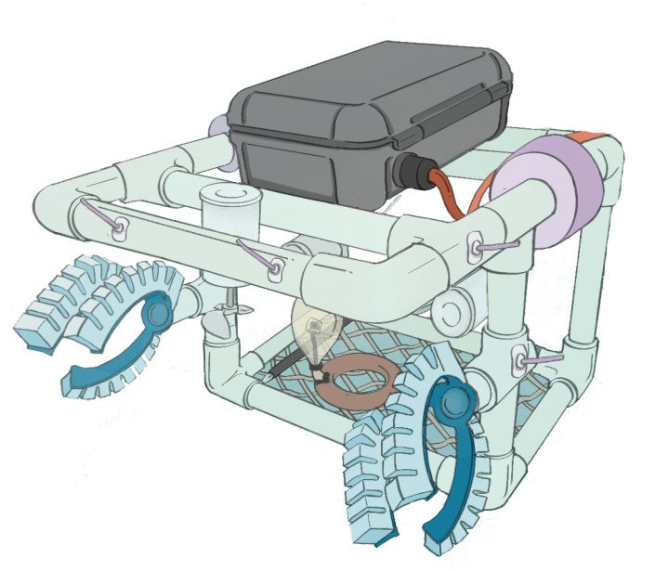
Design and Development of Underwater ROV
By-
Rajeev Kumar
Sahil Bhardwaj
Under the supervision of-
Dr. Navaneeth K. M.
At-
Thermo-Fluids Lab IIT Ropar

Slide 2
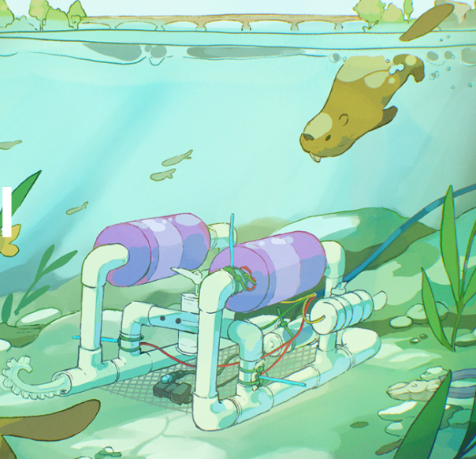
Introduction:
Underwater exploration and data collection are essential in environmental monitoring, research, and inspection tasks. However, most available Remotely Operated Vehicles (ROVs) are expensive, complex, and not suitable for beginners or educational purposes.
This project aims to design and develop a low-cost, modular, and Wi-Fi-controlled underwater ROV that can be easily built, operated, and maintained. The proposed ROV offers basic navigation, depth sensing, and stability suitable for shallow-water applications.

Slide 3
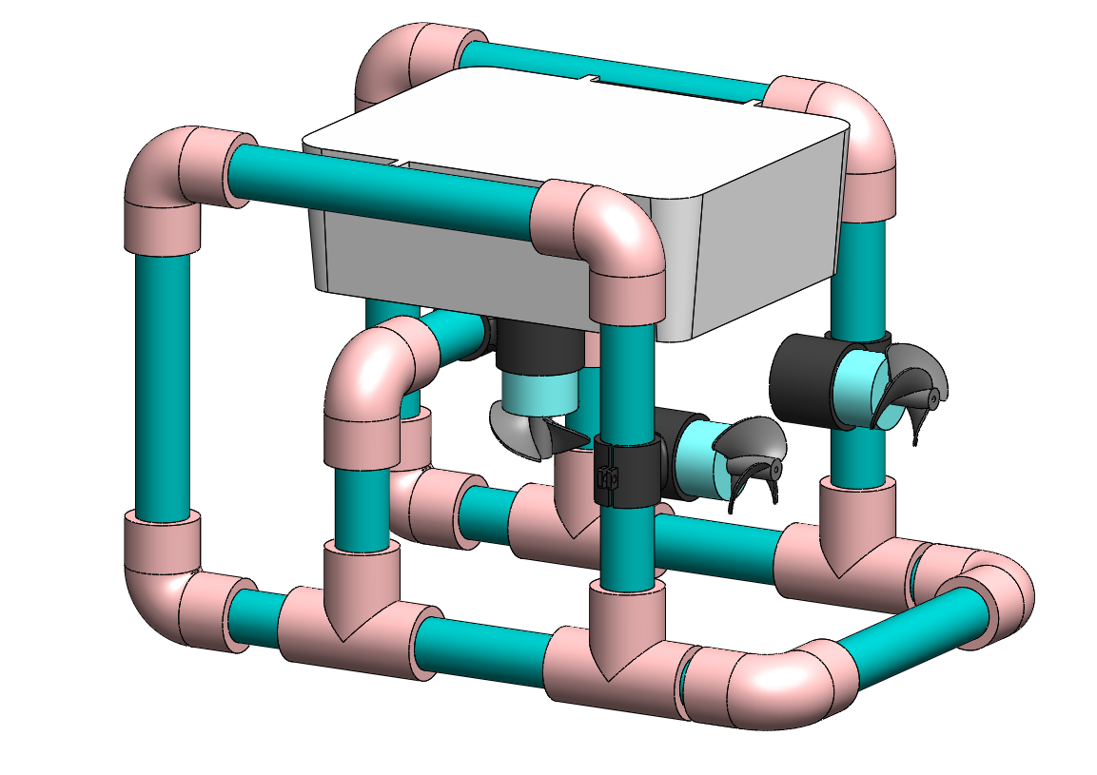
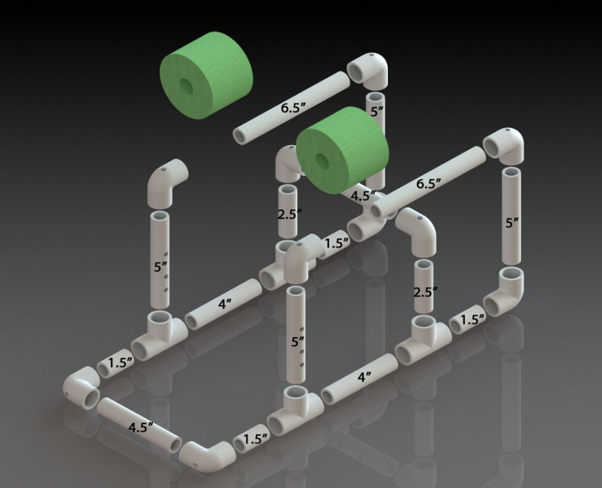
1.1 Modelling of ROV
The frame of the ROV is constructed using ¾ inch PVC pipes and compatible fitting connectors.
PVC is chosen due to its lightweight, water resistance, and ease of assembly.
The frame ensures structural integrity while maintaining a compact and hydrodynamic profile.
SolidWorks model of ROV-1
Dimensions of pipes in inches.

Slide 4
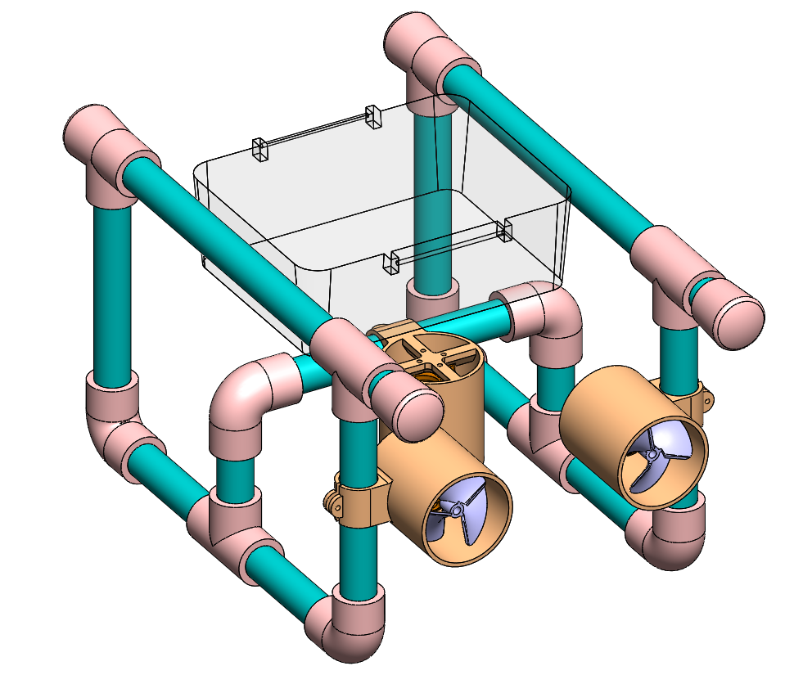
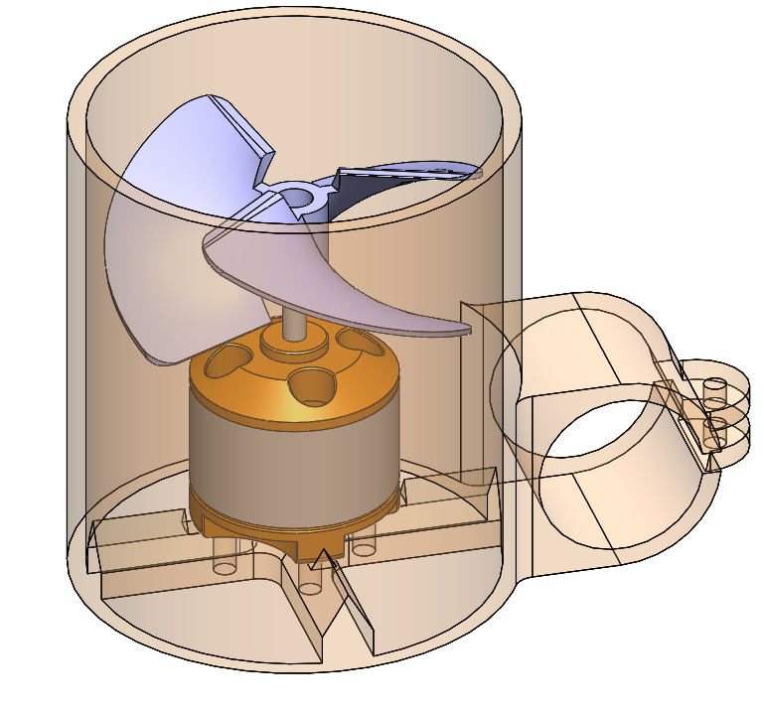
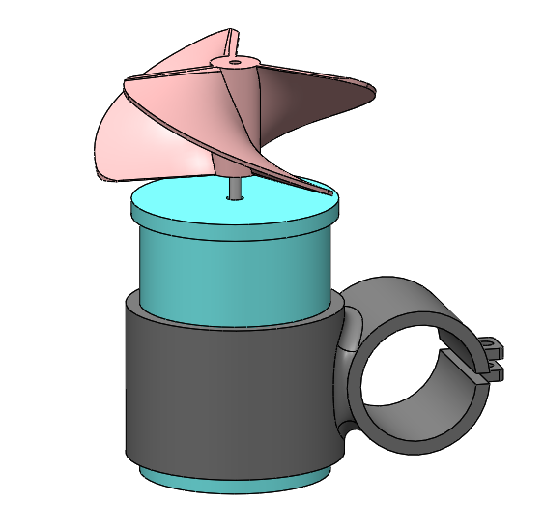
1.2 Model-2 with BLDC motors
In the second model, we used A2212 11.1v BLDC motor.
It one motor has power rating of 100W which is 5 times more than the RS385 DC motor with 20W
SolidWorks model of ROV-2
BLDC motor holder
RS385 DC motor holder

Slide 5
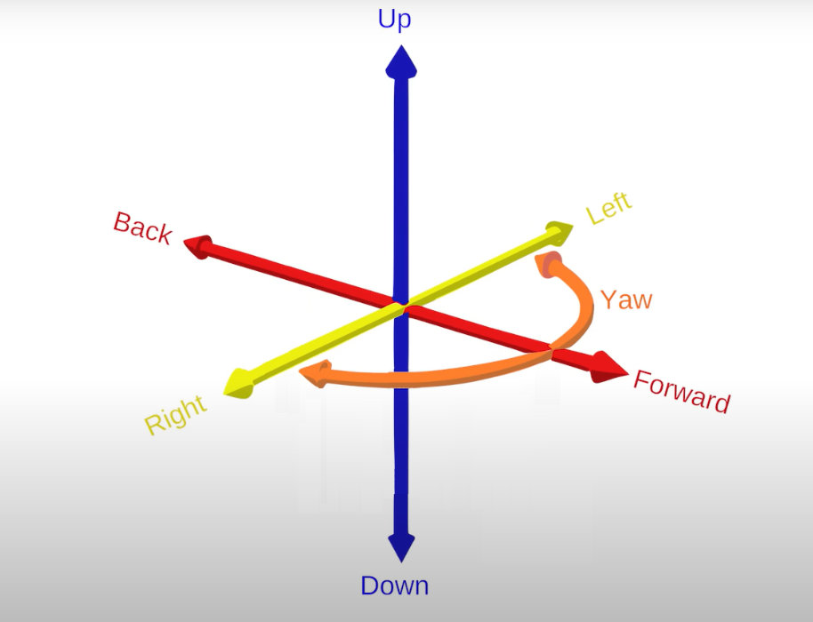
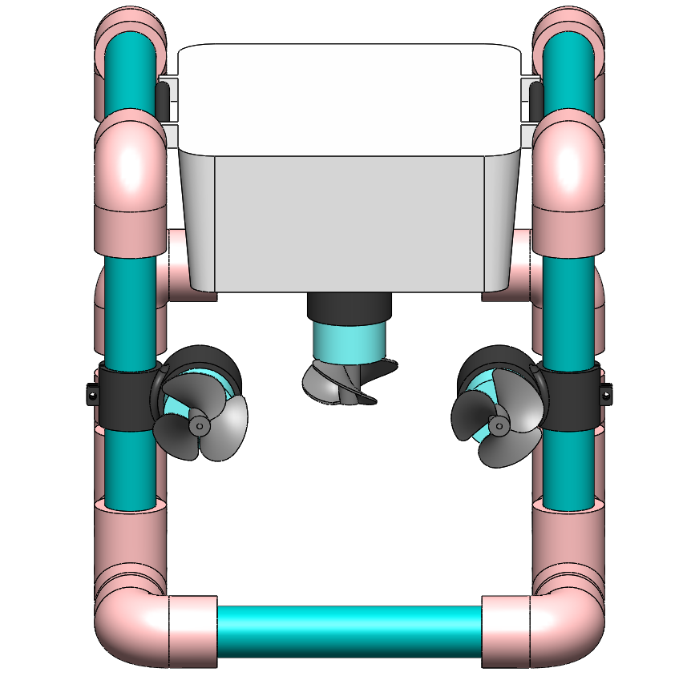
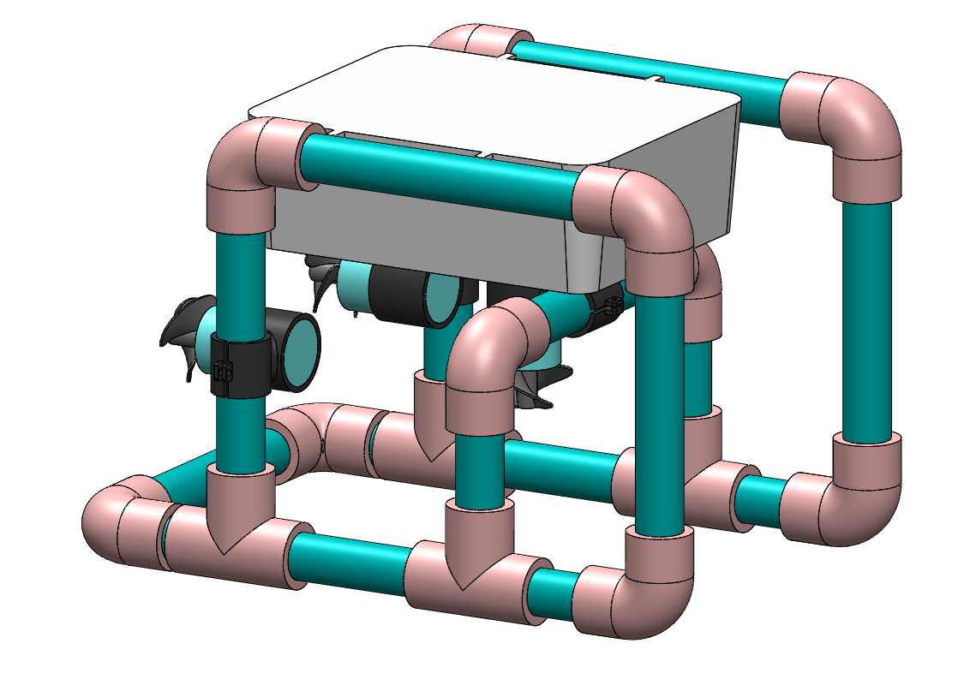
2. Propulsion and Control Mechanism
Three 12V RS385 brushed DC motors are used for movement.
Center Motor: Controls vertical movement (diving and surfacing).
Side Motors: Equipped with clockwise (CW) propellers to manage horizontal directions—forward, backward, left, and right.
Differential thrust is applied for turning and speeding using L298N motor driver.

Slide 6
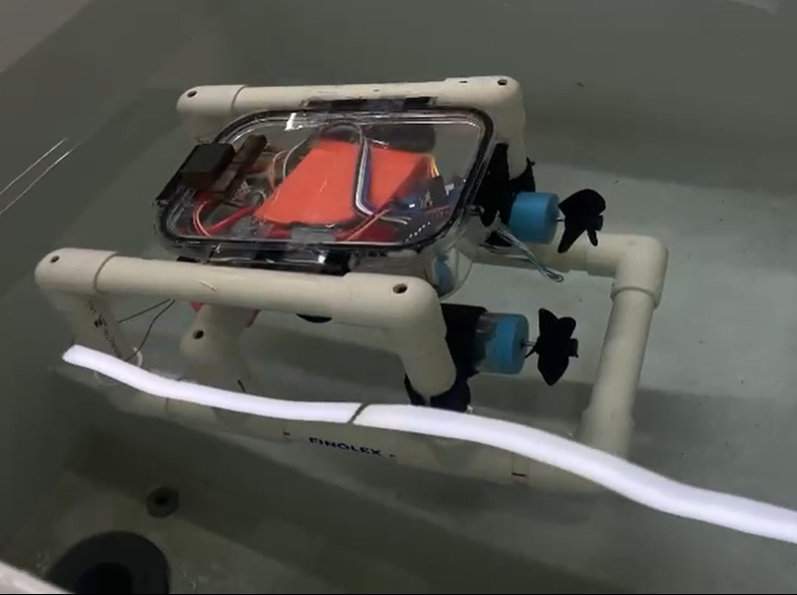
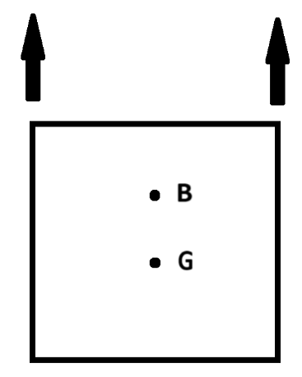
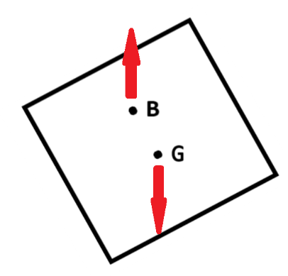
3. Underwater Stability:
The ROV maintains stability through the natural alignment of buoyancy and gravity:
Center of Buoyancy (B): The point where the buoyant force acts.
Center of Gravity (G): The point where the weight acts.
When tilted, a restoring couple is generated between B and G, bringing the ROV back to a vertical position for stability.
Under water image of ROV

Slide 7
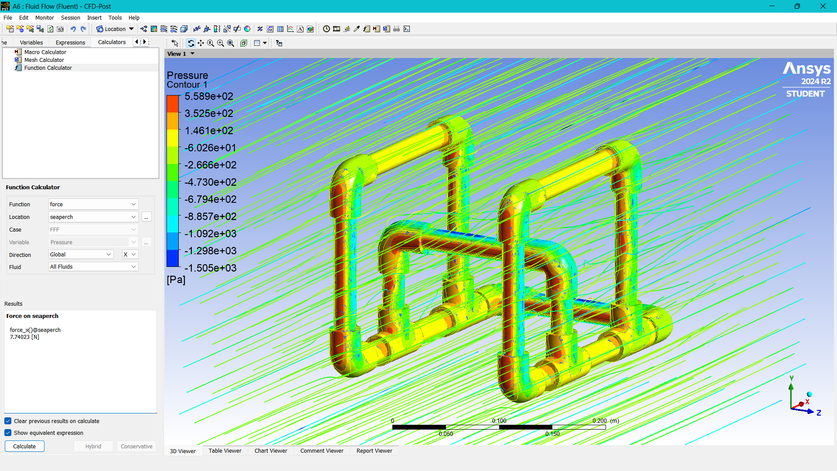
4. Water Drag Simulation of the ROV:
Drag force on model calculated using
Ansys Fluent:
7.7403 N at velocity 1 m/s

Slide 8
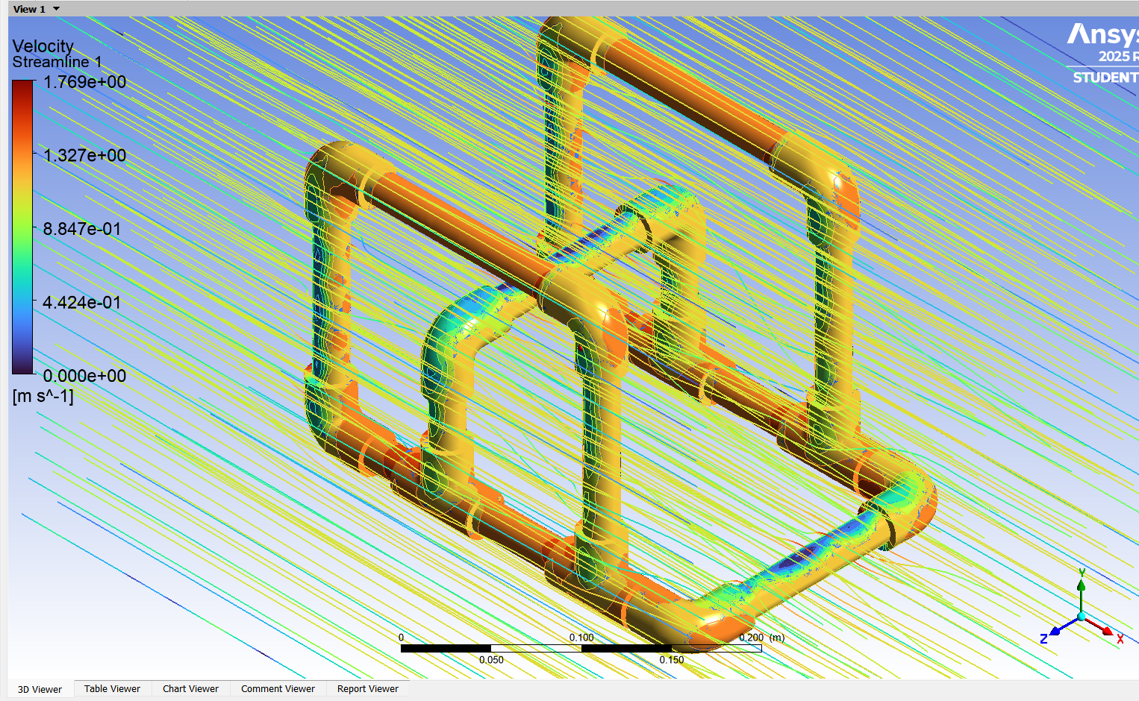
Fluid velocity variation relative to the model

Slide 9
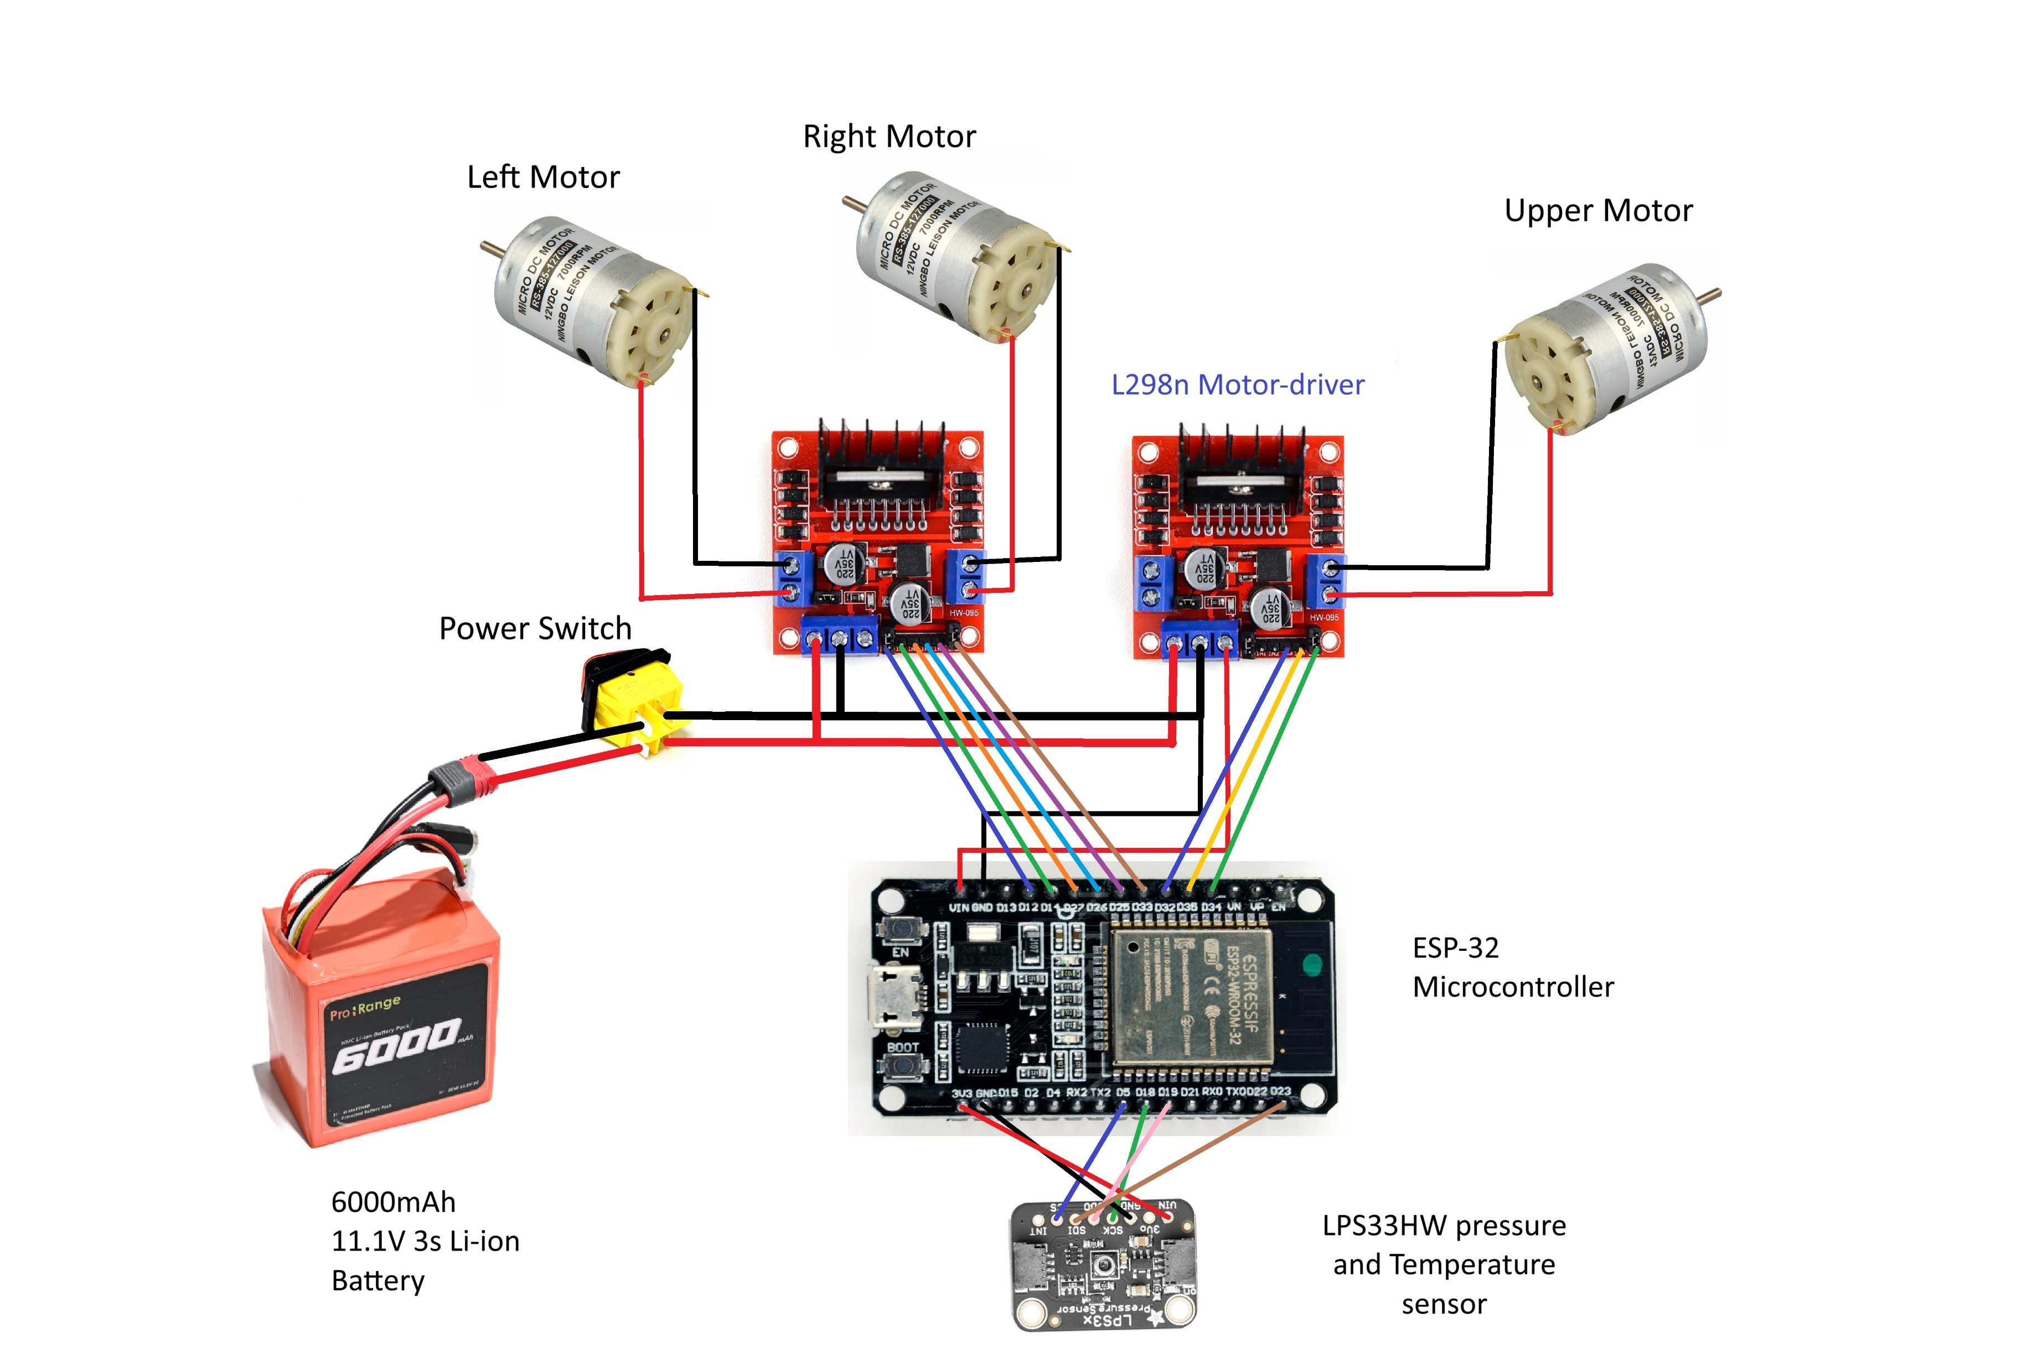
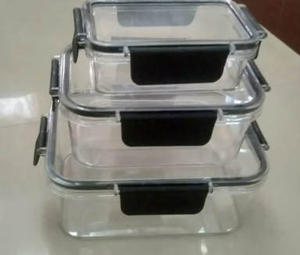
5.1 Circuit Diagram

Slide 10
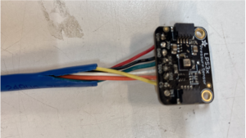
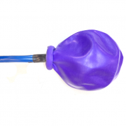
5.2 Depth Measurement:
We are using Adafruit LPS33HW water-resistant barometric pressure sensor which measures the atmospheric pressure and temperature.
Pressure Range: 260 hPa to 1260 hPa (hectopascals) = 260 mbar to 1260 mbar = 26 kPa to 126 kPa
Maximum Usable Water Depth:
= 1260 hPa - 1013 hPa = 247 hPa over atmospheric
= 2.47 m (approx. 8.1 ft)
Adafruit LPS33HW Water Resistant Pressure Sensor
Water proofing of pressure sensor

Slide 11
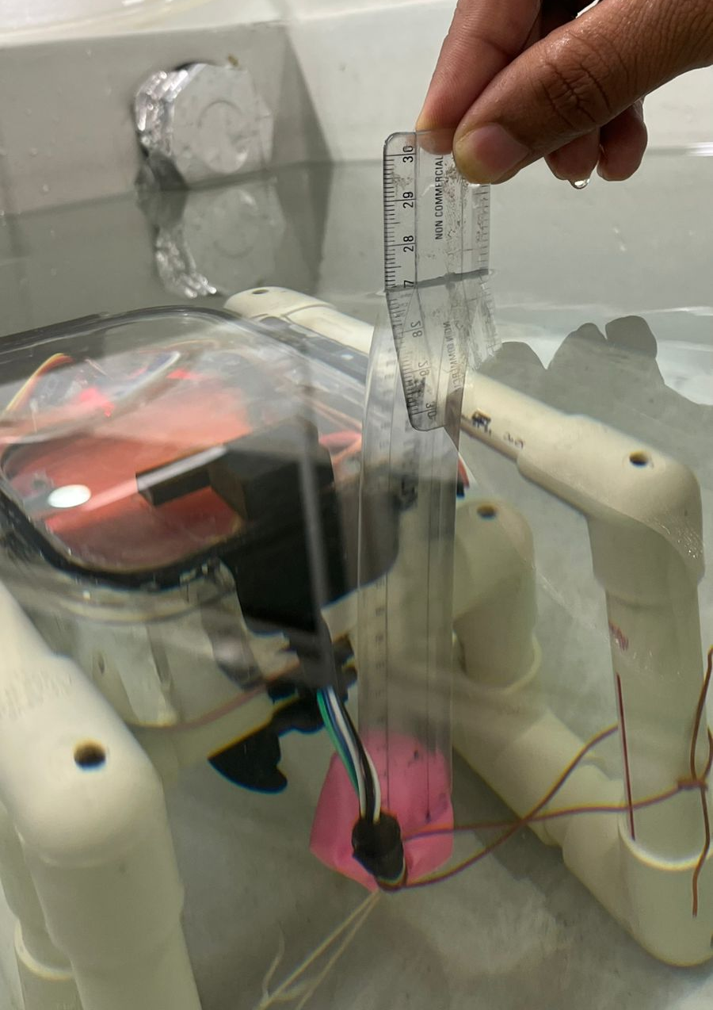
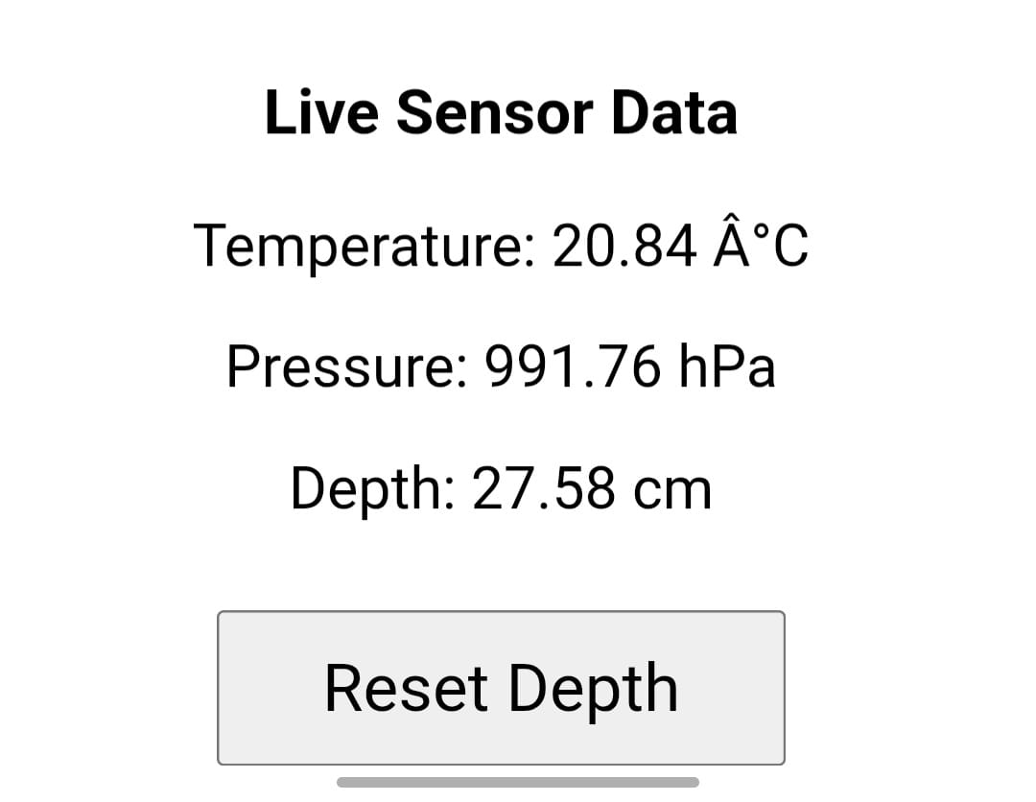
Sensor’s reading: Temperature and Pressure
Measured depth of sensor position: 27 cm

Slide 12
6. Depth Limit:
Method | Description | Effective Depth
ESP32 Wi-Fi only | Direct control from phone to underwater ESP32 | 0 – 40 cm max
ESP32 with cables for power transfer | Controlling ROV from ground power source | Up to 10 – 15m (Due to voltage drop issue)
Tethered UART or Ethernet | Transferring signal using ethernet cable with microcontroller | 100+ meters

Slide 13
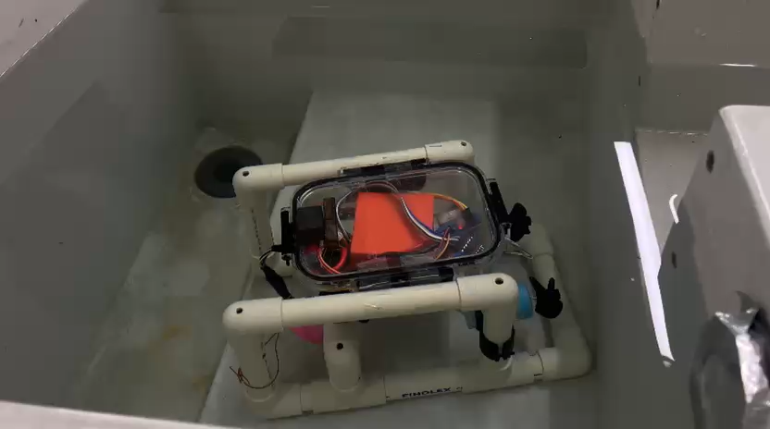
7. Testing of model:

Slide 14

8. Applications of the ROV:
Underwater Inspection and Exploration in Shallow Waters
Explore underwater environments where human access is difficult, risky, or not feasible—such as narrow pipelines, submerged structures.
Educational Tool for Robotics, Hydrodynamics, and Sensor Integration
How motors, controllers, and electronic components work together in real-time.
How buoyancy, drag, and fluid forces affect movement and stability underwater.
Environmental Monitoring in Ponds, Tanks, and Rivers
Studying fish populations and aquatic vegetation.
Inspecting water quality in polluted areas.
A robot exploring inside the water filled mine.

Slide 15
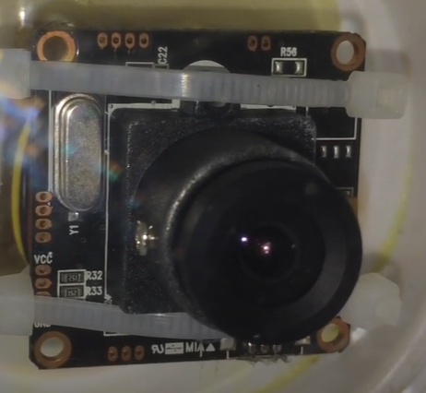
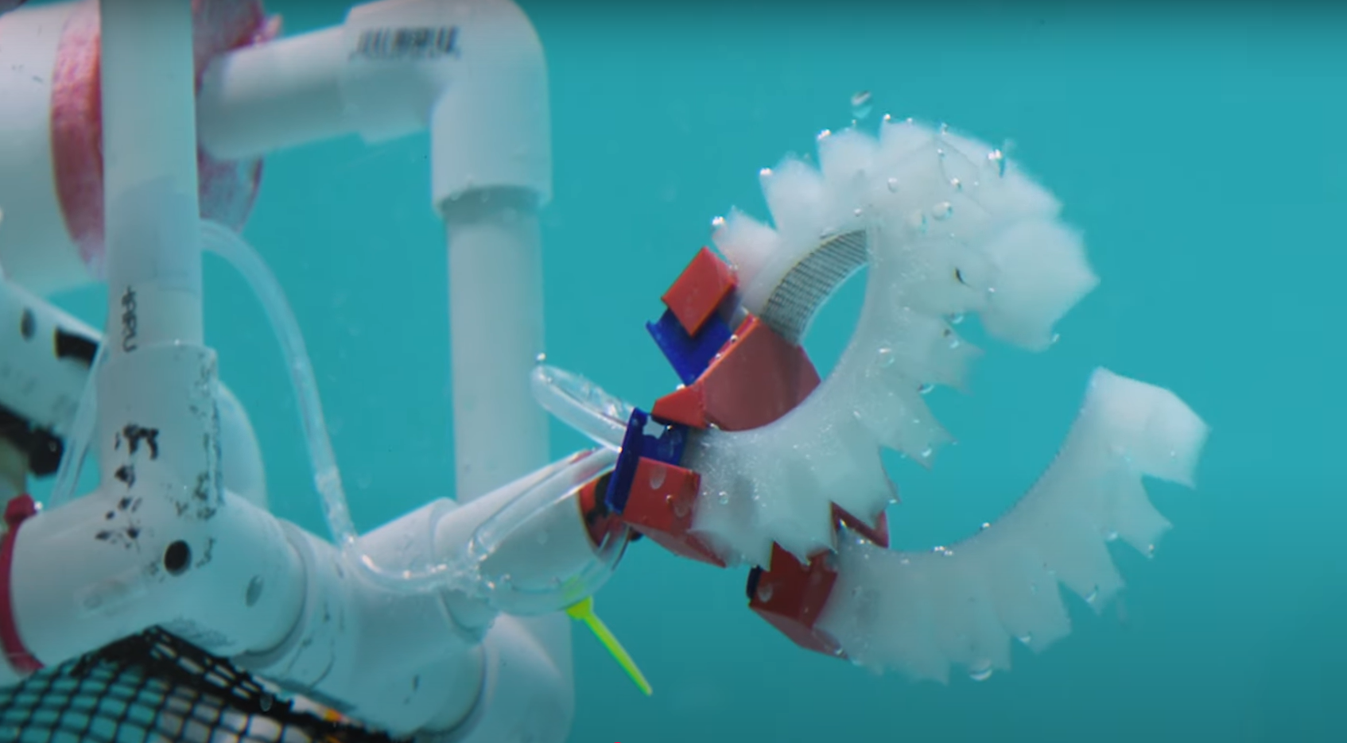
9. Future Improvements:
Add waterproof underwater camera for live underwater video streaming.
Improve waterproofing of electrical components.
Increase depth range with more robust pressure sensors.
Holding Grippers:
We will attach a soft robotic gripper to hold and uplift any underwater object. Which can be operate by using hydraulic pressure mechanism

Slide 16
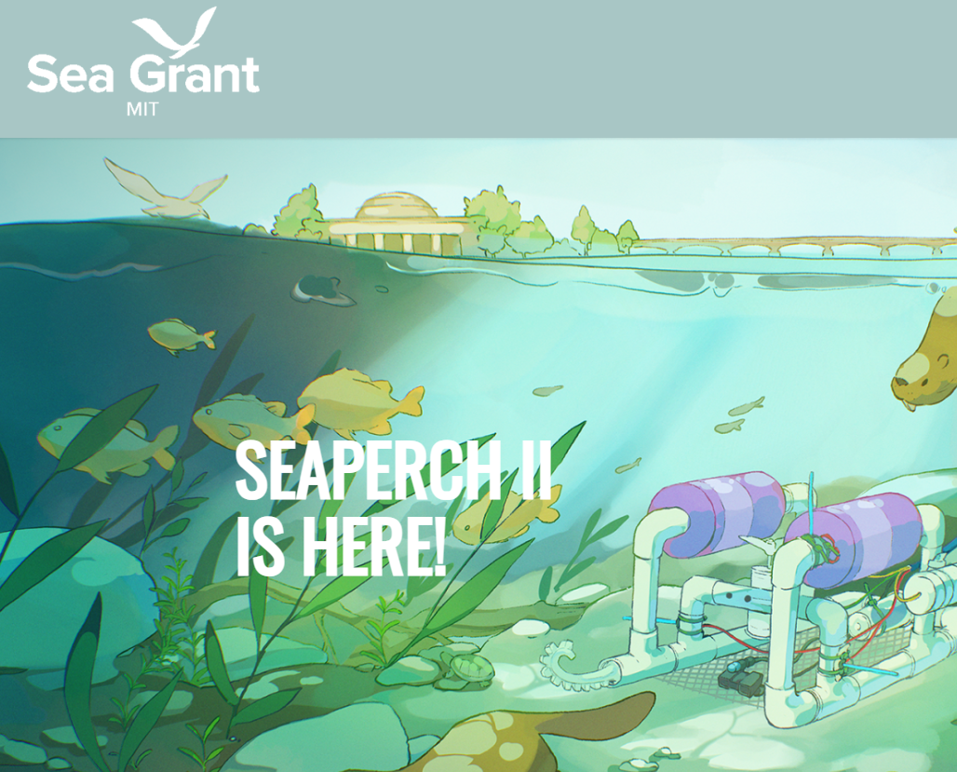
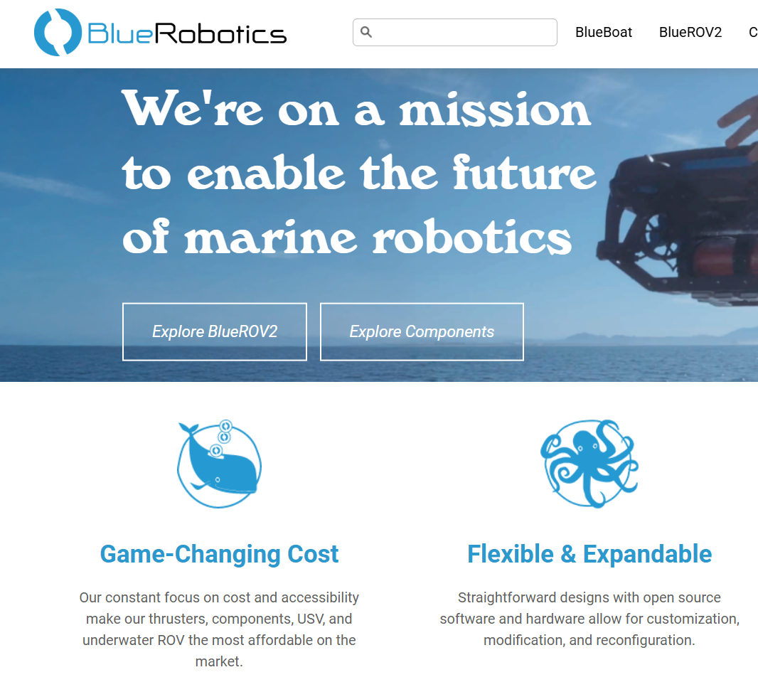
10. References
MIT SeaPerch programme: SeaPerch is an underwater robotics program that started at MIT Sea Grant in 2003 https://seagrant.mit.edu/seaperch2/
Blue Robotics: Blue robotics is underwater robots making company which has made several underwater ROV for marine exploration.
https://bluerobotics.com/

Slide 17
Thank You

